Slide 1


Color Image Encryption Using Hyper Chaotic Map
Major Project (Group No. 17)
Prepared By :
Under the guidance of :
Dr. Om Prakash Singh Assistant Professor
Alok Ranjan (2101075CS)

Slide 2

Outline of the Persentation:
Introduction
Problem Statement
Methodology
Chaos-based Image Encryption
Key Analysis
Histogram Analysis
Entropy Analysis
Correlation Analysis
Chi-Square Analysis
Differential analysis
Robustness Analysis
SSIM & PSNR .
Performance and Time Complexity
Conclusion
References

Slide 3
Introduction:
The secure transmission and storage of sensitive digital data over open channels demand strong security and authenticity [1]. Every second, over 2,266 photos are uploaded to Facebook [2] and 995 to Instagram [3], increasing the risk of data breaches.
Initiatives like Digital India (GOI, 2015) highlight the growing need for secure digital document handling [4]. With identity theft being a major contributor to fraud in India and globally [5], protecting visual data is more critical than ever.
Moreover, issues like the authentication of COVID-19-related images and health data [6] emphasize the demand for reliable and secure image encryption systems.
This project explores a chaos-based encryption method to ensure fast, lightweight, and robust protection for sensitive image data.

Slide 4
Problem Statement:
How can we effectively protect billions of sensitive images shared every day especially critical ones like military surveillance data when traditional encryption methods like AES and RSA are too slow, lack fine-grained pixel-level security, and are vulnerable to modern attacks? Isn’t there a need for a faster, lightweight, and more secure encryption technique specifically designed to safeguard image data in real time against advanced threats?

Slide 5

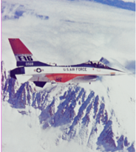
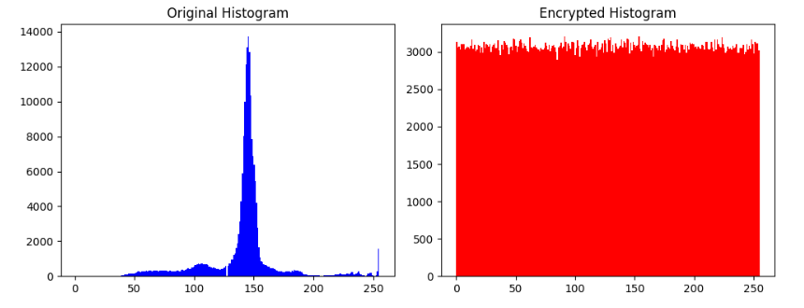
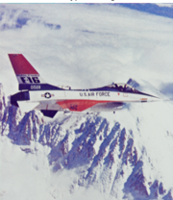
Methodology :
Input: Original Image
Key Generation Module • SHA-256-based seed • QR-Code derived key
Chaos Sequence Generation • 3D Hyperchaotic System
• 2D Memristor Map
Pixel-wise XOR with chaotic sequence
Encrypted Image
Encrypted Image
Performance Evaluation • Histogram & Entropy Analysis • Correlation (Pixel & Channel) • Differential (NPCR, UACI)
Original Image
Histogram Result
Accuracy Verification • Compare with original • Evaluate SSIM, PSNR
Robustness Testing • Noise Attack • Cropping • Rotation & Resizing • Anomaly Detection
Image Decryption Module • Reverse chaotic operation • Reconstruct original image
Decrypted Image
Fig 1: Proposed Methodology

Slide 6
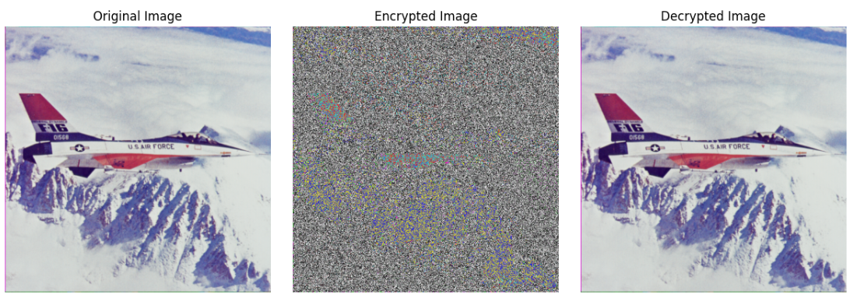
Chaos-Based Color Image Encryption
This project uses chaos theory to encrypt images by generating pseudo-random sequences from 3D hyperchaotic and 2D memristor maps. A secure key is generated using SHA-256 hashing and encoded as a QR code. The chaotic sequences derived from these maps are used in a pixel-wise XOR operation with the original image, producing an encrypted image with high randomness. The 3D system offers better diffusion and security, while the 2D map provides simplicity and faster performance.
Fig 2: Encryption Using 3D Hyperchaotic map

Slide 7
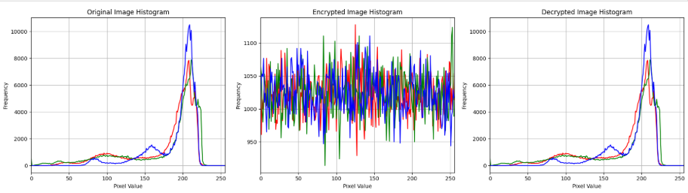

Histogram Analysis
In this project, histogram analysis reveals that the original image has sharp intensity peaks, while the encrypted image shows a flat, uniform histogram. This confirms that the encryption process effectively removes identifiable patterns, enhancing resistance to statistical attacks and making the cipher image visually unpredictable.
Fig 3: Histogram Analysis of Aeroplane Image

Slide 8
Entropy Analysis
Table 1: Entropy Values of the RGB Channels of Different Images
Image Name | Image | Red | Green | Blue
Lena | Original | 7.3042 | 7.5887 | 7.085
 | Encrypted | 7.9962 | 7.9966 | 7.9965
 | Decrypted | 7.3042 | 7.5887 | 7.085
Bella | Original | 5.715 | 5.3738 | 5.7117
 | Encrypted | 7.9974 | 7.9974 | 5.9971
 | Decrypted | 5.715 | 5.3738 | 5.7117
Aeroplane | Original | 6.7178 | 6.799 | 6.2138
 | Encrypted | 7.9993 | 7.9992 | 7.9993
 | Decrypted | 6.7178 | 6.799 | 6.2138
Peppers | Original | 7.3388 | 7.4963 | 7.0583
 | Encrypted | 7.9993 | 7.9993 | 7.9993
 | Decrypted | 7.3388 | 7.4963 | 7.0583

Slide 9
Correlation Analysis
Table 2: Correlation Coefficients Comparison Between Plain and Encrypted Images
Image Name | Image | Horizontal | Vertical | Diagonal
Lena | Original | 0.9241 | 0.9616 | 0.8967
 | Encrypted | 0.0026 | 0.0053 | -0.0037
 | Decrypted | 0.9241 | 0.9616 | 0.8967
Bella | Original | 0.9761 | 0.9142 | 0.8973
 | Encrypted | 0.0007 | 0.0092 | 0.0044
 | Decrypted | 0.9761 | 0.9142 | 0.8973
Aeroplane | Original | 0.9663 | 0.9641 | 0.937
 | Encrypted | 0.0023 | 0.001 | -0.0003
 | Decrypted | 0.9663 | 0.9641 | 0.937
Peppers | Original | 0.9768 | 0.9792 | 0.9639
 | Encrypted | 0.0053 | -0.0006 | 0.0025
 | Decrypted | 0.9768 | 0.9792 | 0.9639

Slide 10
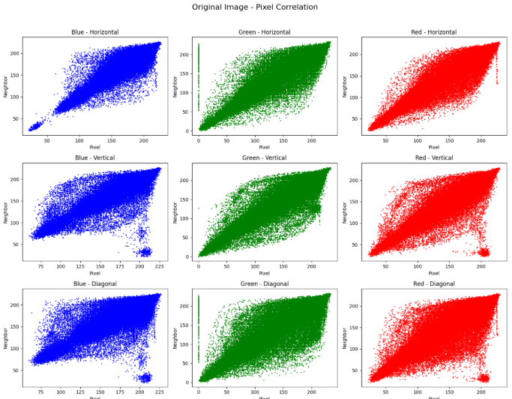
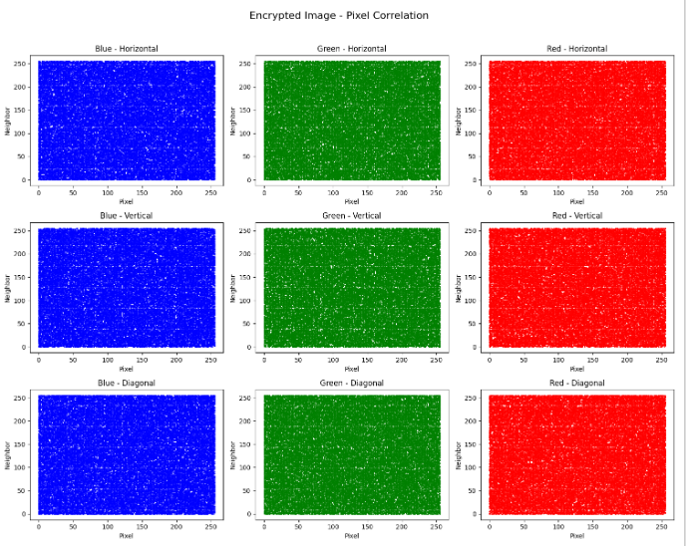
Correlation Analysis :
Fig 4: Correlation Analysis of Aeroplane Image

Slide 11
Chi-Square Analysis :
Chi-Square analysis checks how randomly pixel values are distributed in an encrypted image. In this project, it helps verify that the chaotic encryption (using 3D Hyperchaotic ) makes pixel values uniformly spread, hiding patterns. A lower Chi-Square value means better encryption and stronger resistance to statistical attacks.
Table 3: Chi-Square Analysis of Encrypted Image
Image | Blue | Green | Red
Lena | 247.0217 | 242.1671 | 269.1299
Bella | 261.8594 | 234.1250 | 239.3359
Aeroplane | 251.4551 | 279.9668 | 237.3848
Peppers | 266.5312 | 258.1465 | 252.5273

Slide 12
Differential Analysis :
NPCR (Number of Pixel Change Rate): Measures the percentage of pixels that change between the original and encrypted image when a slight change is introduced. A higher NPCR indicates that small changes in the plaintext or key produce significant alterations in the ciphertext, which is a desirable property for secure encryption.
UACI (Unified Average Changing Intensity): Measures the average intensity change between corresponding pixels in the original and encrypted images. A higher UACI suggests that even minor changes in the key or plaintext lead to substantial changes in pixel values, indicating stronger encryption.
Table 4: NPCR and UACI Values for the RGB Channels of the Color Image
Image | NPCR Value | UACI Value
Lena | 99.59% | 33.43%
Bella | 99.62% | 33.55%
Aeroplane | 99.61% | 33.43%
Peppers | 99.56% | 33.40%

Slide 13
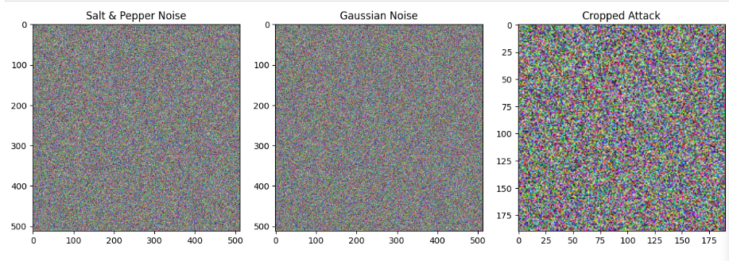
Robustness Analysis
In this project, robustness analysis was performed to test the resistance of the encryption method against common image distortions such as noise addition (Gaussian, salt-and-pepper) and cropping. These distortions simulate real-world transmission errors or malicious tampering. The results show that the decryption process, especially when using the 3D Hyperchaotic map, effectively reconstructed the original image even after such attacks. This demonstrates that the proposed chaotic encryption approach offers strong robustness and reliability, ensuring secure image transmission and protection under various adverse conditions.
Fig 5: Encrypted image under Salt & Pepper Noise, Gaussian Noise, and Cropping Attack

Slide 14
SSIM & PSNR
Table 5: Robustness Analysis of Aeroplane Image
Type of Attack | Strength | PSNR | SSIM
Salt & Pepper | 0.5% | 50.51535 | 0.876684
Salt & Pepper | 0.2% | 54.43611 | 0.946571
Salt & Pepper | 0.1% | 57.71505 | 0.972350
Gaussian | 1.0% | 39.78263 | 0.945155
Gaussian | 0.5% | 42.56620 | 0.970877
Gaussian | 0.1% | 48.21067 | 0.993389
Crop | 1/16 | 30.39400 | 0.540760
Crop | 1/32 | 31.21991 | 0.601690
Crop | 1/64 | 32.16800 | 0.706383

Slide 15
Performance and Time Complexity Analysis
The 3D Hyperchaotic map demonstrated strong security with high randomness and resistance to attacks. Although it involved slightly higher computation time due to complex dynamics, it maintained acceptable performance, making it suitable for secure image encryption applications.
Image | PSNR | SSIM
Lena | 40.99 dB | 0.4425
Bella | 41.48 dB | 0.2565
Aeroplane | 40.57 dB | 0.3648
Peppers | 40.82 dB | 0.3427
Table 6: Encryption Time Comparison of the Color Image
Image | Encryption Time | Decryption Time
Lena | 0.053 ms | 0.040 ms
Bella | 0.040 ms | 0.030 ms
Aeroplane | 0.231 ms | 0.189 ms
Peppers | 0.166 ms | 0.139 ms

Slide 16
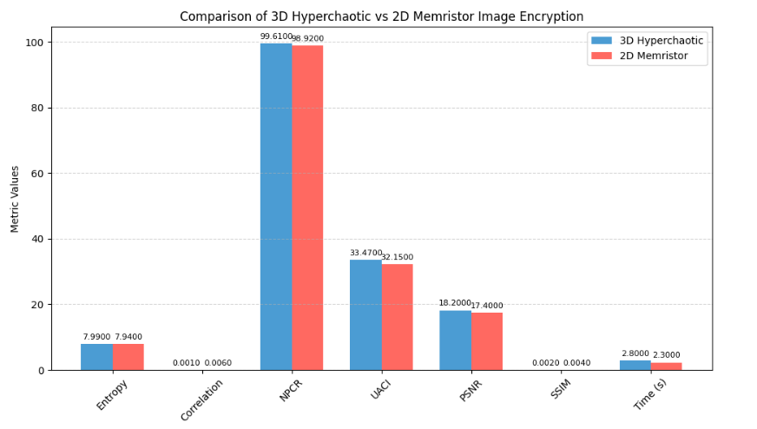
Conclusion
This project successfully demonstrates a secure and robust image encryption and decryption scheme using chaos theory. By leveraging 3D Hyperchaotic and 2D Memristor maps, we ensured high entropy, low pixel correlation, and strong resistance to statistical, differential, and geometric attacks. The experimental results validated the system’s strength through detailed analysis including histogram, entropy, PSNR, SSIM, and anomaly detection. Among the two, the 3D Hyperchaotic map offered better diffusion and security, while the 2D Memristor map provided faster execution with slightly lower randomness. Overall, chaos-based encryption proves to be a powerful tool for protecting visual data.
Fig 6: Comparison of 3D Hyperchaotic Vs 2D Memristor Image Encryption

Slide 17
References
Z.-H. Guan, F. Huang, and W. Guan, "Chaos-based image encryption algorithm," Physics Letters A, vol. 346, no. 1–3, pp. 153–157, 2005.
F. Özkaynak, "Role of NPCR and UACI tests in security problems of chaos-based image encryption algorithms," Optik, vol. 127, no. 24, pp. 10303–10311, 2016.
Z. Lin and H. Liu, "Constructing a non-degeneracy 3D hyperchaotic map and application in image encryption," Chaos, Solitons & Fractals, vol. 183, 2024, Art. no. 113745.
C. Li, J. Lü, and J. Kurths, "Dynamic analysis of digital chaotic maps via state-mapping networks," IEEE Transactions on Circuits and Systems I: Regular Papers, vol. 66, no. 7, pp. 2652–2665, 2019.
A. K. Farhan, F. Belkhouche, and M. H. Alshammari, "Entropy analysis and image encryption application based on a new chaotic system crossing a cylinder," Entropy, vol. 21, no. 6, p. 602, 2019.
https://sipi.usc.edu/database/database.php?volume=misc&image=37#top

